Slide 1
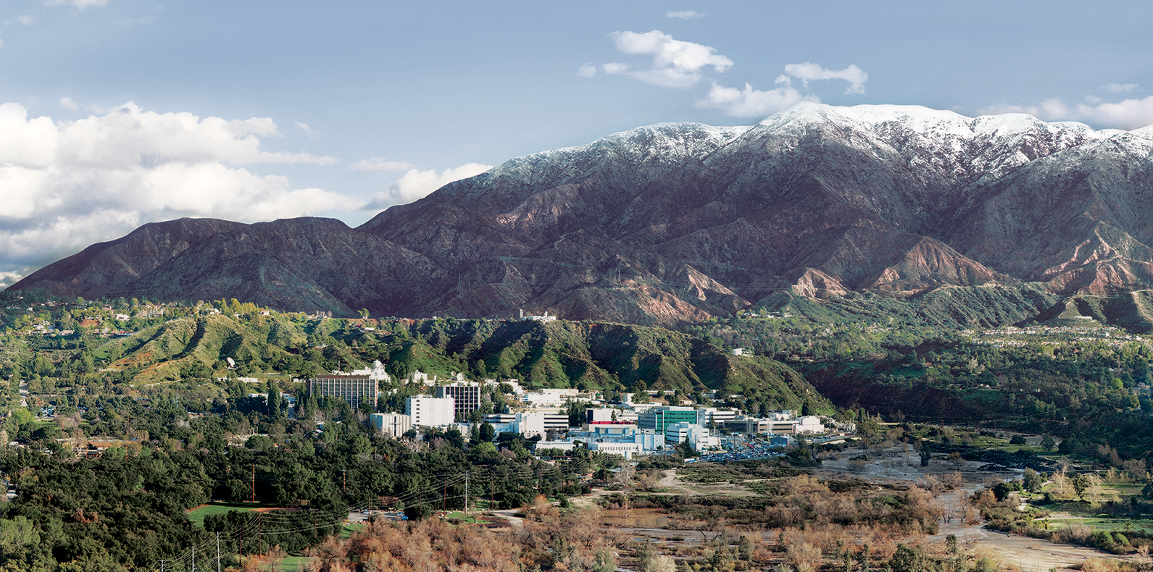
10. Noise, Distortions, and the MNF Transform
Dr. David R. Thompson
Jet Propulsion Laboratory, Imaging Spectroscopy Group
July 20, 2019

Slide 2
Goals for this module
Recognize different flavors of instrument noise and systematics
Estimate instrument noise from imaging spectroscopy data
Calculate the Minimum Noise Fraction (MNF) transformation

Slide 3
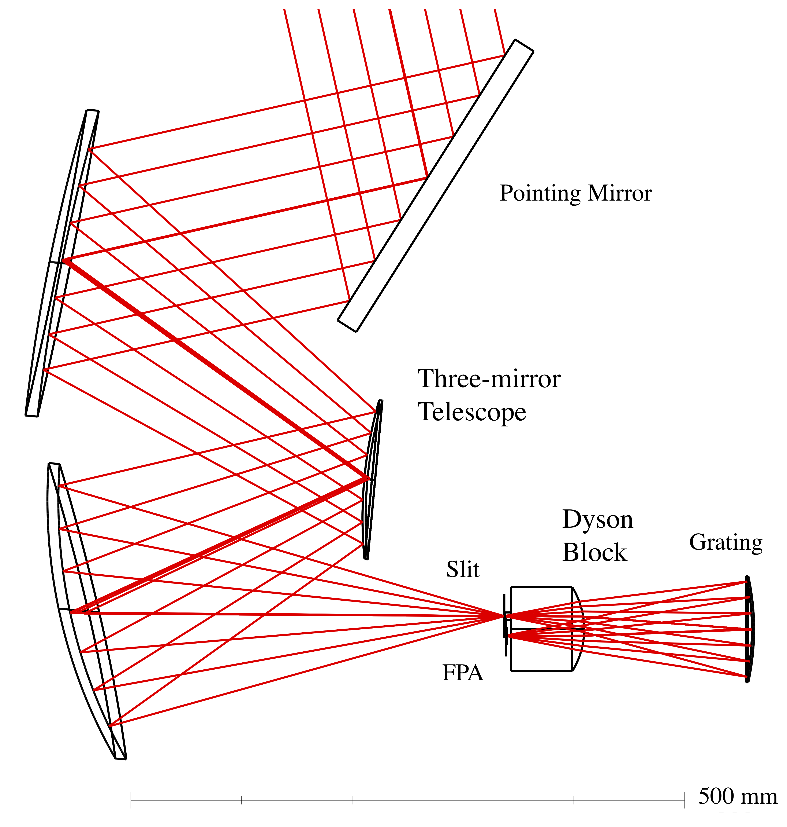
Physical instruments produce various flavors of distortion:
Photon shot noise: magnitude is square root of signal due to Poisson counting statistics
Electronic read noise: magnitude is usually independent of signal
Nonlinearities: departure of radiometric response from idealized proportional description
Other Systematics: Optical ghosting, electronic panel effects, calibration error, etc.
Highly instrument-specific.
Our emphasis
Telescope
Slit
Focal Plane
Array
Grating

Slide 4
Estimating Noise Part I: First Principles Method
In this approach we calculate radiometric uncertainty by forward propagation of photon counting and electronic noise statistics
We fit models by analysis and/or laboratory characterization
Note that Signal to Noise Ratios (SNRs) are signal-dependent in shot noise-limited systems
Pro: SI-traceability; component-wise models; high accuracy
Con: In-flight validation & updates difficult, pathological illumination, tricky to get covariance structure
Telescope
Slit
Focal Plane
Array
Grating

Slide 5
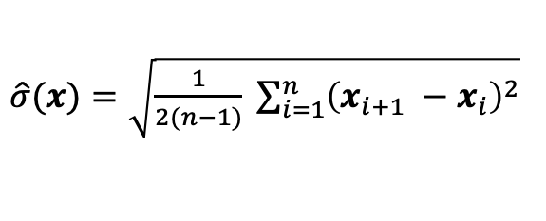
Estimating Noise Part II: Scene-based noise estimation
This alternative estimates radiometric uncertainty directly using empirical statistics of the data.
It is easier than vicarious characterization, because it does not require in situ data. But it does typically require a spatially homogeneous target area so it is not suitable for all scenes.
We use Von Neuman’s approximation based on pairwise differences:
…applied separately in each channel, preferably along pushbroom (down-track) dimension to characterize each element independently.
$\hat{σ}(x)=\sqrt{\frac{1}{2(n−1)} \sum_{i=1}^{n}{{\left(x_{i+1} −x_{i}\right)}^{2}}}$
[Von Neumann, J. Ann. Math. Statist. 12 367–395. (1941). MR0006656]

Slide 6
Scene-based noise estimation (continued)
Crudely speaking, the differences between neighboring locations in homogenous areas represent samples of the instrument noise.
This can be used to construct sample-based covariance matrices using the approaches presented previously.
The covariance matrix defines a zero-mean multivariate Gaussian noise distribution.
[From Thompson et al., RSE 2019]

Slide 7
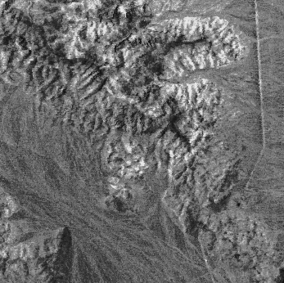
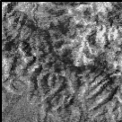

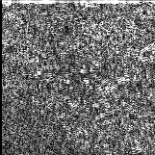
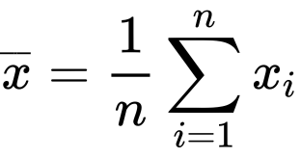
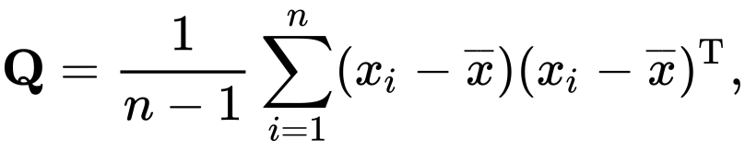
Scene-based noise estimation (continued)
If the scene is not spatially homogeneous, it might still be locally smooth. This leads to an alternative based on nonparametric smoothing.
Estimate the ”scene contribution” by convolving a local smoothing operator (e.g. a Gaussian) and subtract that signal.
Then estimate noise with our empirical expression for the sample covariance matrix:
Scene, smoothed in the downtrack dimension
“Noise contribution”
is the remainder
Original Image
Subset (550 nm)
Total = Scene + Noise
[Thompson et al., Optics Express 2017]

Slide 8
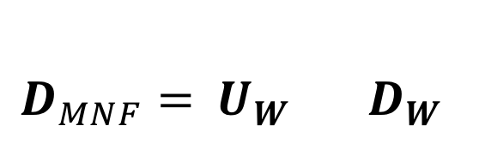
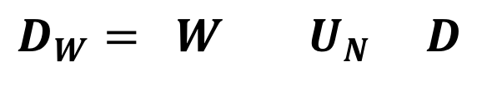
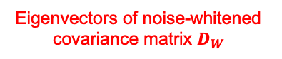
The MNF transformation
The Minimum Noise Fraction (MNF) transformation is a linear orthogonal basis similar to PCA, but forcing noise in each channel to be unity. It is actually the product of two rotations, e.g. noise-”whitening” and PCA:
Make the signal zero mean (subtract µ from each spectrum)
Calculate the eigenvalues and eigenvectors of the noise covariance, perhaps with SVD
“Whiten” the noise to remove influence of noise covariance
Apply Principal Component Analysis
Result: PCA, but scaled so that noise level is unity
Eigenvectors of noise covariance N
Noise-whitened data matrix
$$D_{W}= W { U}_{N} D$$
Diagonal matrix, reciprocal of square root of N’s eigenvalues
Zero-meaned data matrix
Data in MNF projection
$$D_{MNF}={ U}_{W} { D}_{W}$$
Eigenvectors of noise-whitened covariance matrix $D_{W}$
As detailed in: A. A. Green, et al, IEEE Trans. Geosci. Remote Sens., vol. 26, no. 1, pp. 65–74, Jan. 1988.

Slide 9
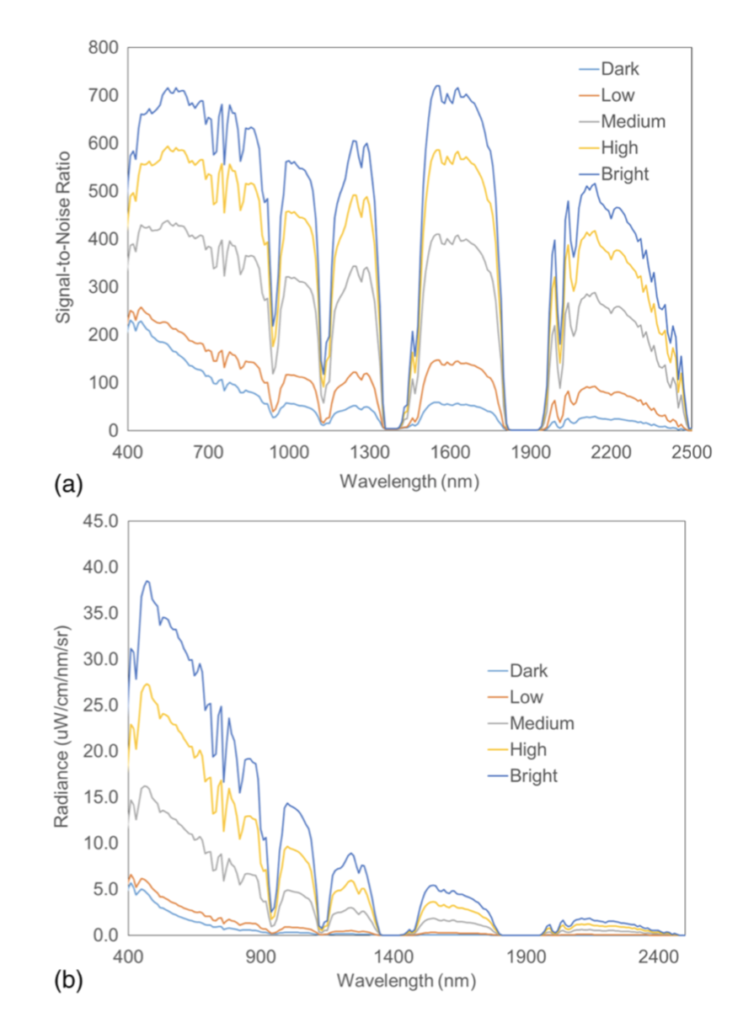
Typical SNR curves
Image From Mouroulis et al., Optics Express, 2016
Signal to Noise Level (SNR) is one of several ways to describe noise.
The Noise-equivalent change in radiance (NeDL) is another.
Recall that both are dependent on the signal level – this is because photon shot noise dominates illumination-independent terms as more photons are counted.

Slide 10
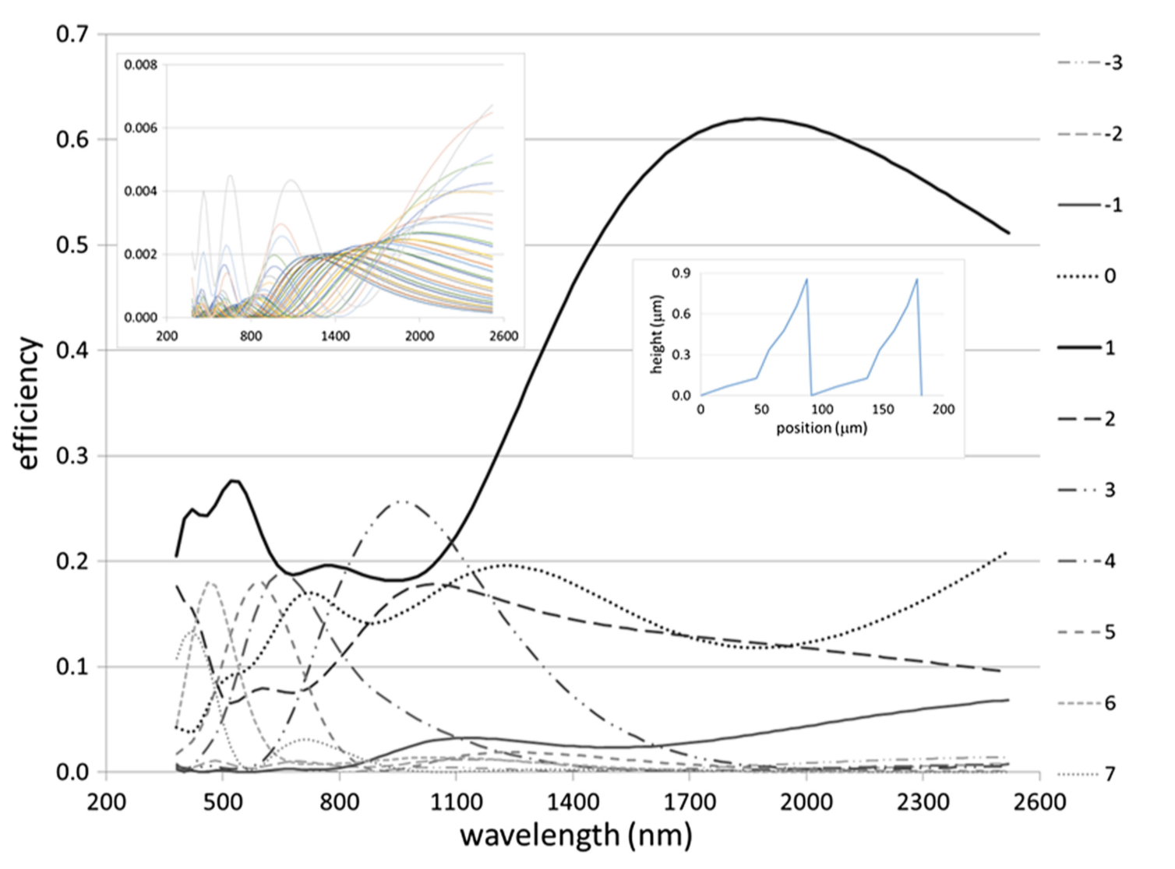
Tuned grating efficiencies
From Mouroulis et al., OE 2016

Slide 11
Bonus: accounting for relative calibration drift
This panel shows in-flight estimates of calibration drift in the PRISM imaging spectrometer. Vertical lines relate to FPA electronic effects.
Estimating this from flight data permits updated synthetic flat field and per-element instrument noise estimation. We image a uniform target area, and then calculate the systematic differences between neighboring pixels on the focal plane array.
[Thompson et al., Remote Sensing of Environment 231, 2019]

Slide 12
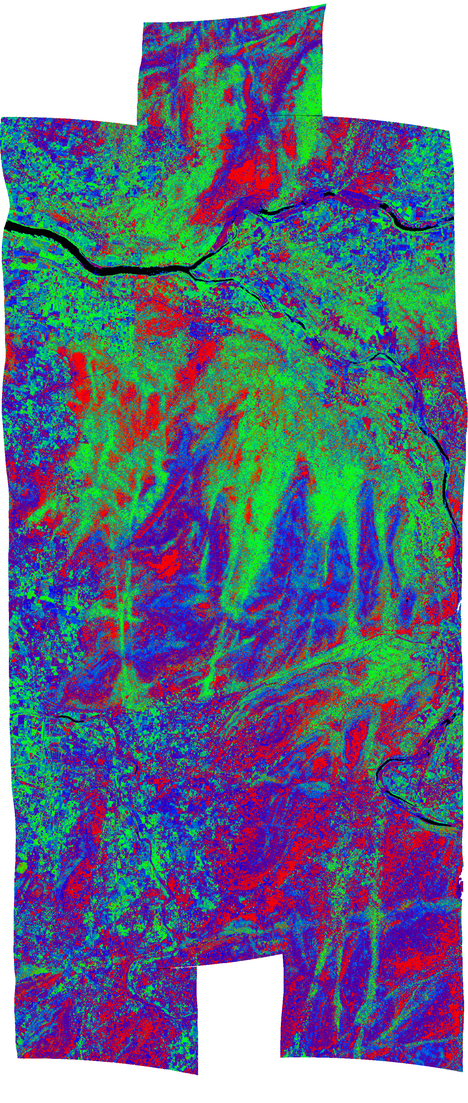
There are many other potential error sources
Investigators should be aware of the uncertainties at each step in their analysis:
Raw Digital Numbers
Radiance at sensor
Surface Reflectance
Geophysical Map
Detector sensitivity drift
Transient or systematic electronic effects
Long term degradation and contamination
Spectral response uncertainty
Atmospheric unknowns (aerosol types, gas and particle vertical profiles)
Bi-directional reflectance
Topographic effects
Temporal variability
Retrieval models
Generalizing local parameterizations
Diverse in-situ data sources
Quantization error (bit rate)
(Influenced by observation noise)

Slide 13
Climatological uncertainties: AOD550
Atmospheric correction may also introduce errors, particularly in conditions with high Aerosol Optical Depth (AOD).
AOD is the Beer-Lambert extinction coefficient due to aerosols, typically reported at a single wavelength like 550 nm.
Certain regions of the world have more atmospheric aerosols than others.
MODIS average AOD550
EBF
C
B
WS
U
CM
ENF
DF
S
PW
DBF
MF
OS
G
CS
Land cover classification
[Thompson et al., Remote Sensing of Environment 232, 2019]

Slide 14
Climatological uncertainties: water vapor
Aerosols are particularly challenging when present with high water vapor content in the atmosphere.
The next section describes new atmospheric correction methods intended to handle these tricky combinations.
MODIS average water vapor gm cm⁻²
EBF
WS
S
CM
DBF
CS
PW
C
U
ENF
MF
OS
G
B
DF
Land cover classification
[Thompson et al., Remote Sensing of Environment 232, 2019]

Slide 15
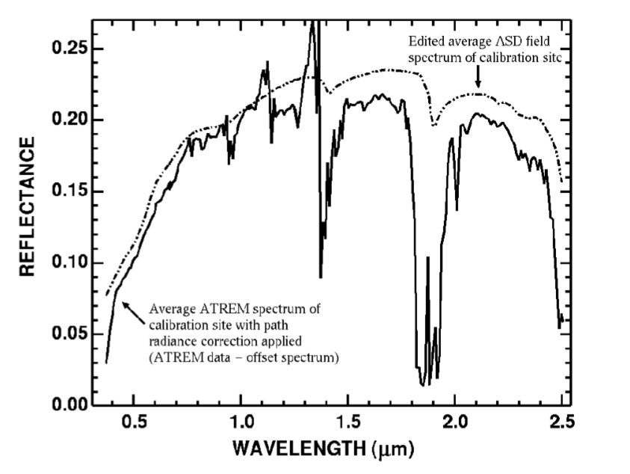
Atmospheric correction artifacts
From Clark et al., 2002.
It is common for reflectance spectra to show spikey “residuals” in water vapor features where the model does not quite match true atmospheric conditions.
Look to the red arrows (940 nm and 1140 nm bands) for these issues.
The 1380 and 1880 nm dips are due to extreme absorption (the atmosphere is opaque). These regions are typically ignored.

Slide 16
Atmospheric aerosol-related artifacts
Here we see some additional aerosol artifacts that appear in a vegetation reflectance profile.
Reduced contrast lowers height of 720 nm “red edge”
Aerosols distort the H₂O vapor absorption shapes causing residual “spikes”
Path radiance causes an upslope near 400 nm
Different aerosol optical types have different effects on the spectrum. Some tend to absorb strongly (e.g. soot) while others are “scattering” (e.g. some dust). Their signatures may have different shapes depending on the specific particle shape, composition, and size.

